Slide 1
RESEARCH MRI Safety Training
CBIR
University of Maryland
Center for brain imaging research

Slide 2
THE MAGNETIC FIELD IS AT FULL POWER ALWAYS ….IT IS ALWAYS “ON”.

Slide 3
Who is this training for?
MRI safety training is required for all faculty, staff and students who will work around and inside the MRI magnet rooms or will need access to the area.

Slide 4
Overview of Topics
Safety training schedule
Potential dangers of MRI
Safety Signage
Importance of proper safety
Regulating those around you
Emergency situations

Slide 5
Safety training schedule
Safety training should be completed annually and will consist of:
Filling out a personal MRI Screening Form
Reviewing safety PowerPoint
Watching the MRI safety video
Passing the MRI safety quiz

Slide 6
MRI Screening Form
To ensure patient safety, completion of the
MRI screening form is required prior to every MRI scan.
The MRI Screening Form is used to help identify any potential dangers for you and your patients / subjects.
The form consists of a series of questions intended to identify any metallic objects within your body that could be affected by the magnetic field.
2 screening forms are required:
- During the consent process (RA)
- Before the MRI (MRI Operator)

Slide 7
MRI Screening Sheet
All Patients will need
this form filled out
before an MRI can be done.
Ideally, the form should be
filled out by:
a. The Patient
If the patient cannot fill it out:
b. Family Members
If there are no family members:
c. Referring MD

Slide 8
MPRC_MRI Screening Forms

Slide 9
EMPLOYEE SAFETY
ALL EMPLOYEES MUST BE SCREENED TO WORK IN A MAGNETIC FIELD ENVIRONMENT JUST LIKE THE PATIENTS.
NO EXCEPTIONS.

Slide 10
Patient Screening and Contraindications
NO ONE should enter the scan room without first being cleared by an MRI operator.
Some implants/devices are contraindications for an MRI scan
If a subject answers “yes” to any question on the MRI screening form, that issue must be addressed and resolved prior to entering the scan room
NO cardiac pacemakers, defibrillators, aneurysm clips or electronic or magnetically activated devices

Slide 11
Patient Screening and Contraindications (Continued)
Any injury from a foreign metallic body may be a contraindication for an MRI scan
If someone has worked as a machinist, grinder, or welder and cannot absolutely confirm they always wore eye protection, they must first have orbital x-rays to confirm that there are no loose metallic bodies in the eye
Any person who was injured by a metallic foreign body such as a bullet, BB, or shrapnel may not be able to proceed with an MRI scan unless there is proof that any remaining metal in the body is not in a location where it may move and cause injury/death.

Slide 12
MRI Safety Video
Watch the MRI safety video at:
mms://vidsrv1.mc.duke.edu/Radiology/MRISafety.wmv

Slide 13
Safety Signage

Slide 14
Signage
FDA Guidance for the Submission Of Premarket Notifications for Magnetic Resonance Diagnostic Devices states:
"The controlled access area should be labeled "Danger - High Magnetic Field" at all entries."
The term "warning" does not convey the importance of a situation that may not only be potentially hazardous, but has been responsible for serious injuries and deaths.
14

Slide 15
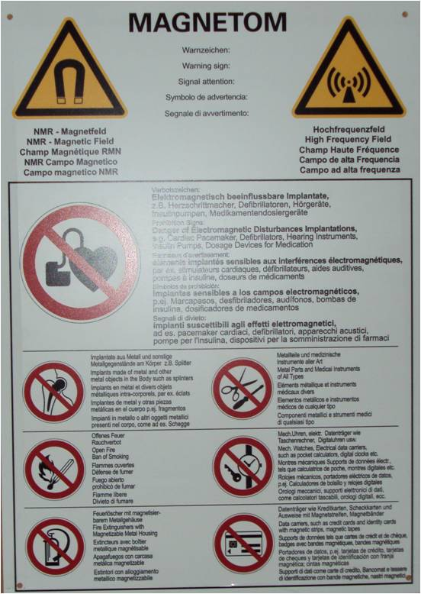
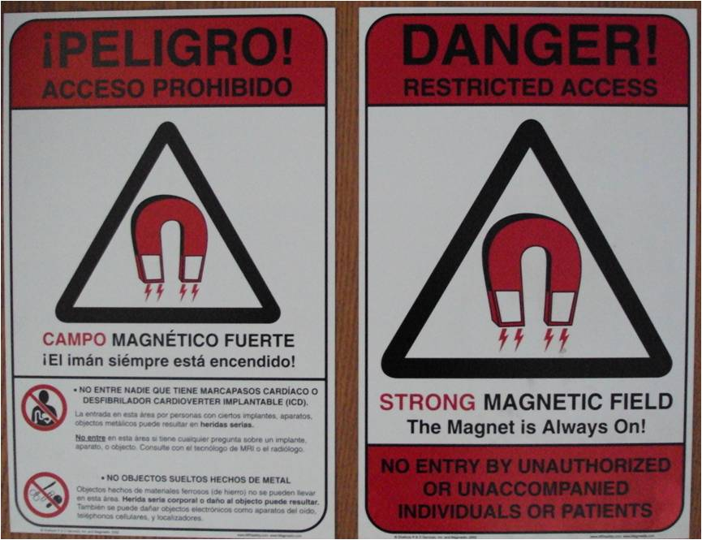
Look for the warning signs!

Slide 16
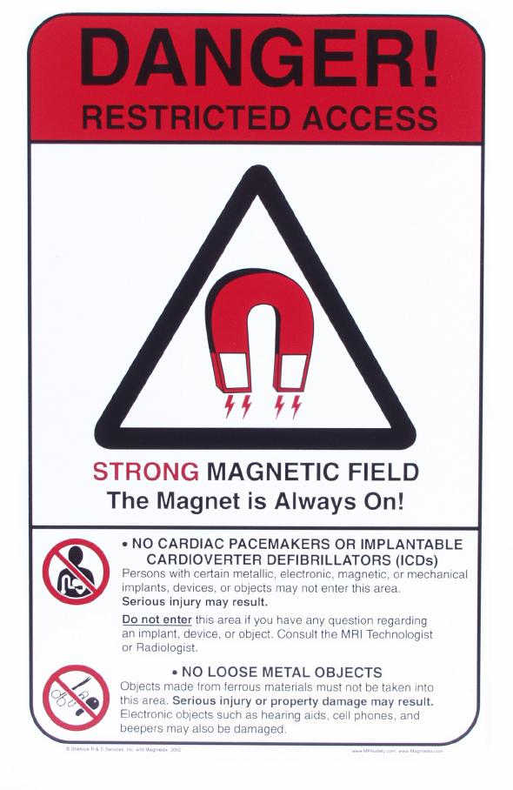
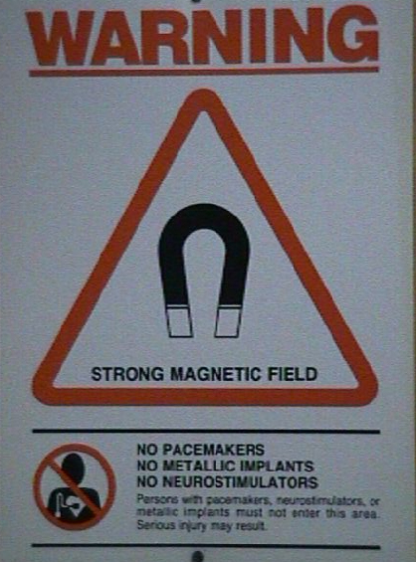
16

Slide 17
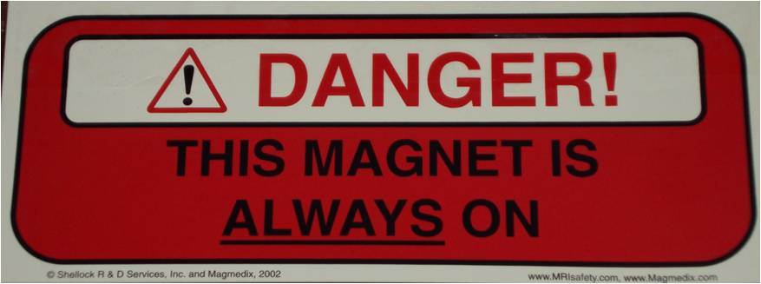
Remember, the magnet is ALWAYS on!
Even when the MRI Scanner is not in use, the magnet is on. Ferromagnetic objects should NEVER be taken into the Scan Room.

Slide 18
MRI safety Zones
The MRI suite is divided into 4 safety zones.
ZONE 1: This region includes all areas
that are freely accessible to the general
public. It is typically outside of the MR
environment itself and is the area
through which patients and all
personnel access the MR suite. This
zone is not marked or labeled.
ZONE 2: This area is between the
accessible zone 1 and the strictly
controlled zones 3 and 4. Patients and
other personnel are able to move
throughout this area. However they
must be mindful of where zone 3
begins. This area is marked with a
safety sign.

Slide 19
MRI Safety Zones
ZONE 3: This area is the region that
non MR safe equipment can result in
serious injury or death if accidentally
moved closer or into zone 4.
Personnel are not to move freely
through this zone. They must be
accompanied by level 2 staff. MR safe
practice guidelines must be adhered to
for the safety of the patients and other
non-MR staff.
ZONE 4 : This zone is the MR suite
itself. Nobody that has not been
screened will enter this zone under any
circumstances. If the screening
process has taken place, you may
enter the suite but you MUST be
accompanied by level 2 MR staff.

Slide 20
MRI Safety

Slide 21
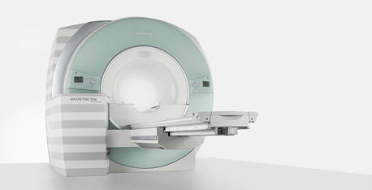
Safety Background
The MRI scanner is a very large and powerful magnet
Most clinical scanners are 1.5 - 3 Tesla scanners
3 Tesla = 30,000 gauss
Earths magnetic field ~ 0.5 gauss
Image Courtesy of Siemens Healthcare

Slide 22
Forces in the MR Environment
Magnetic field
missile effect: TRANSLATION
rotational effect: ROTATION/TORQUE

Slide 23
Translational Force
this term describes the force which attracts ferrous objects to the center of the magnetic field
may act to transform ferrous objects into missiles as they accelerate toward the magnet
the force is greatest when the difference in field strength across the object is

Slide 24
Rotational Force
this force relates to the North - South orientation of the scanner’s magnetic field
ferrous objects will attempt to align their long axes with this orientation
this force will rotate objects until they are aligned and is greatest at the very center of the field (unlike the translational force which is greatest where the difference in magnetic field across the object is greatest)

Slide 25
Characteristics of the Magnetic Field
the force of the field is measured in tesla (T); a typical scanner is approximately 1.5- 3.0 tesla
the force of the field is greatest at the periphery of the magnet. This FORCE INCREASES as you move closer to the magnet.
NOT ALL MAGNETS ARE THE SAME FIELD STRENGTH, THUS THEIR “ATTRACTIVE FORCES” WILL BE DIFFERENT.

Slide 26
What can you take into a magnetic field?
ONLY ITEMS THAT ARE MRI COMPATIBLE. Such as…
Brass
Aluminum
Plastic
IF YOU ARE NOT SURE IF AN OBJECT IS MRI SAFE…DON’T TAKE IT INTO THE ROOM. ASK A MRI Personnel!!!!!!!!

Slide 27
Magnetic Field
Anything that doesn’t contain
iron.
To be safe…TAKE NOTHING
INTO A MAGNETIC FIELD.
Work closely with the
MRI Personnel who works in
that type of environment
each day. Question Everything.
What “objects” can you take into a magnetic field?

Slide 28
Potential Dangers of MRI
Safety Background, potential projectiles, and safety reminders

Slide 29
Potential Projectiles
Any ferromagnetic object may be attracted to the MRI scanner and become a projectile – this is known as the missile effect.
The greater the amount of ferromagnetic material, the greater the force of attraction.
The magnetic field extends beyond the bore of the magnet in all directions (fringe field)
Image Courtesy of Siemens Healthcare

Slide 30
Fringe field
This line specifies the perimeter around a MR scanner within which the static magnetic fields are higher than five gauss. Five gauss and below are considered 'safe' levels of static magnetic field exposure for the general public.

Slide 31
As you approach the magnet, the fringe magnetic field gets STRONGER
31

Slide 32
Projectile Accidents
The MRI magnets are ALWAYS on (24 hours/day, 365 days/year)
There is a STRONG fringe magnetic field around the magnets
The fringe magnetic field is confined to the scan room
32

Slide 33
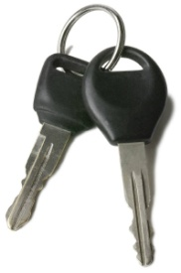
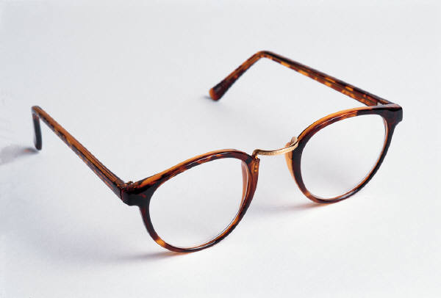
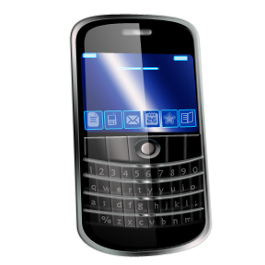
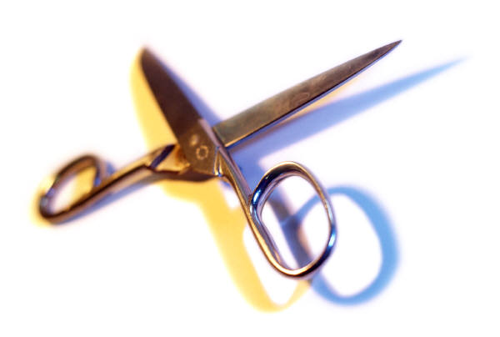
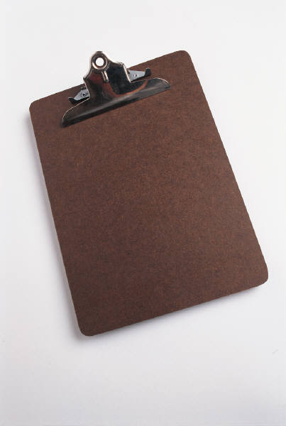
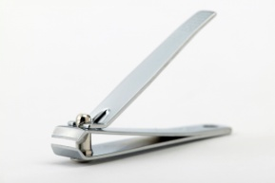
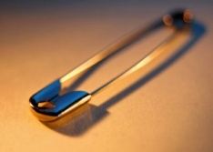
Potential Projectiles - examples
Cell phone
Keys
Glasses
Hair pins / barrettes
Jewelry
Safety pins
Paper clips
Coins
Pens
Pocket knife
Nail clippers
Steel-toed boots / shoes
Tools
Clipboards
No loose metallic objects should be taken into the Scan room!

Slide 34
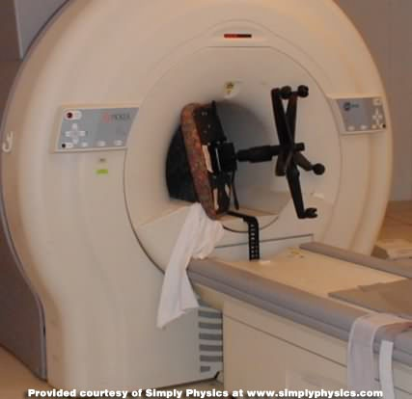
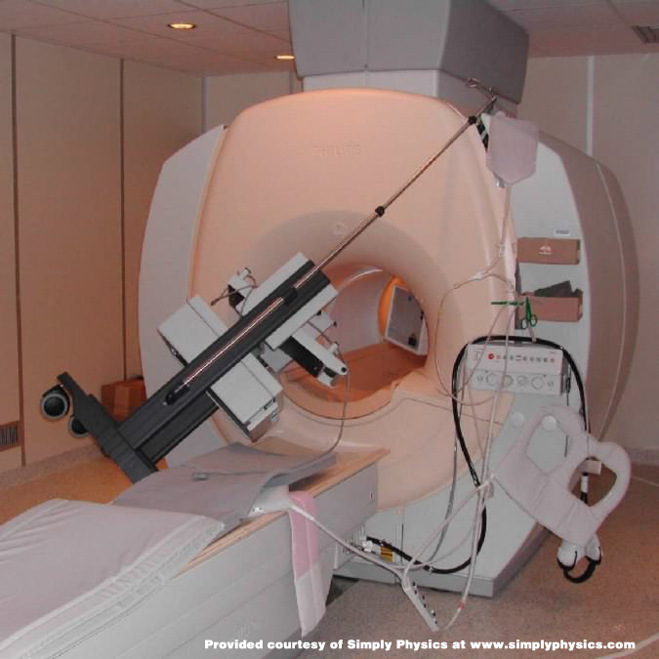
Potential Projectiles – Large Objects
Due to the strength of the magnet, large objects such as chairs and IV poles can become projectiles and get stuck in the magnet!
Photo credit: www.simplyphysics.com

Slide 35
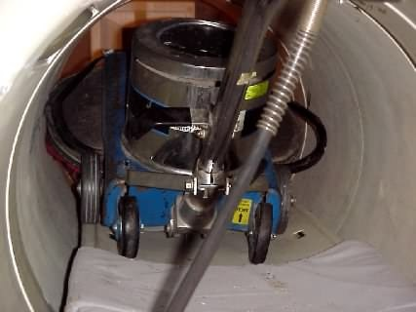
http://simplyphysics.com/flying_objects.html#
35

Slide 36
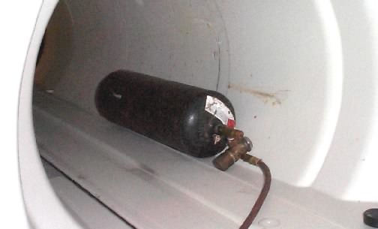
http://simplyphysics.com/flying_objects.html#
36

Slide 38
A Horror Story
Here's one I heard from an Oxford Magnets engineer which was later independently verified by a technologist who had been hired to work at this site.
A brand new magnet had just finished being installed into a brand new building.
All of the acceptance testing had been completed and the magnet was to be turned over to the customer the very next day.
There was only one minor problem to be dealt with first.
One of the sprinklers in the scan room had a tiny leak. A welder was brought in to fix the leak, but somebody forgot to tell him that the magnet was at field.
So..... in walks this welder with his acetylene torch system. His tank flies into the magnet, the valve breaks off, sparks and catches fire.
Since he was in there to fix a leak in the sprinkler system, it had been turned off first.
The brand new building burned to the ground!
http://simplyphysics.com/flying_objects.html#
38

Slide 39
Remember this mnemonic: MRI = Metal Results (in) Injury

Slide 40
Peripheral nerve stimulation (PNS) The rapid switching on and off of the magnetic field gradients is capable of causing nerve stimulation. Volunteers report a twitching sensation when exposed to rapidly switched fields, particularly in their extremities

Slide 41
BURNS
It is “possible” for patients to get 1st, 2nd, or even 3rd degree burns in an MRI if items such as ECG cables are looped and are touching the patients skin (even if these devices are MRI compatible).
All “cables” should not touch the patients skin directly, and should NOT be in a LOOPED configuration.

Slide 42
Safety (continued)
Auditory safety
Activation of gradient magnetic fields produces significant vibrations in the gradient coils.
MRI acoustical noise has been shown to produce reversible hearing impairment and could potentially produce permanent damage.
Hearing protection is recommended for all patients undergoing an MRI procedure on a high-field MRI system (1.5T and 3.0T).
Noise attenuating ear-plugs or head phones are routinely used in MRI
42

Slide 43
Safety (continued)
-FDA Safety Guidelines for MR Devices
-Acoustic noise level
International standard: 140 dB relative to 20 mPa
43

Slide 44
Emergency Shut Down
Press this button in the case of a Fire, sparks, smoke
Disable electrical power to equipment in the scan room.

Slide 45
Another danger in MRI: QUENCH!
MR scanners are supercooled with inert gases such as helium.
If these cryogens BOIL OFF either intentionally or unintentionally, a quench has occurred. THIS IS EXTREMELY BAD.
When to Quench?
Quench is done in an emergency, to run the magnetic field to ZERO in order to remove a projectile/patient from the scanner in extreme emergencies.
If a quench occurs, remove all staff from the room immediately

Slide 46
QUENCH!
THE WORRY WITH A QUENCH IS THE POTENTIAL FOR ASPHIXIATION AND FROST-BITE TO THE HEALTH CARE WORKER AND PATIENT.

Slide 47
Importance of Proper Safety

Slide 48
Why is proper MRI safety so important?
To protect your patient / subject
To protect your co-workers / colleagues
To protect yourself

Slide 49
Regulating those around you

Slide 50
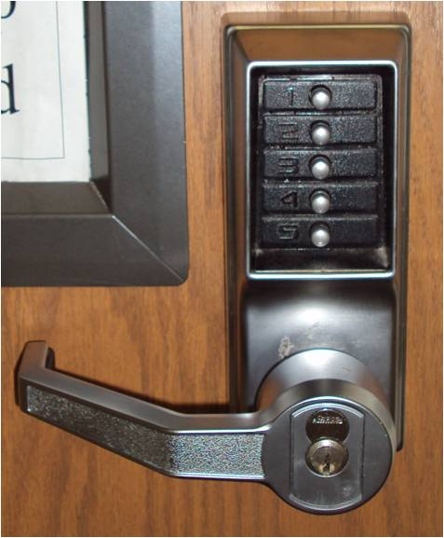
Keep the MR control area safe
Keep doors to the MR control area shut
Do not let people into the MR control area or scanner rooms
Do not share access codes
Monitor your subjects while they are in the MRI area

Slide 51
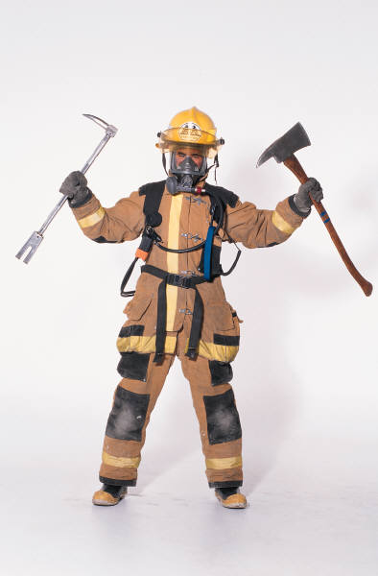
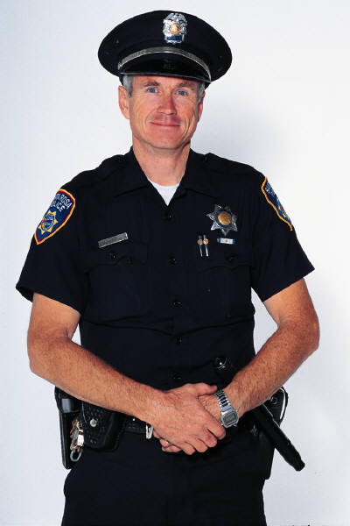
Emergency Situations
In the event of an emergency, you should first remove the subject from the MRI scan room
Stand near the doors to the scan room to insure no unauthorized emergency personnel can enter
NO CODE OR CODE LIKE PROCEDURES WILL BE RUN IN THE MRI ROOM.

Slide 52
Safety Training summary
Annually review your safety training
Always be aware of the potential dangers of MRI
Never take anything metal into the scan room
Always make safety a top priority while in the MRI environment

Slide 53
THE MAGNETIC FIELD IS AT FULL POWER ALWAYS ….IT IS ALWAYS “ON”.

Slide 54
The End

